Slide 1
Artificial Intelligence
Tutorial 01
Manish Shakya (34509621)
(AI)

Slide 2
01
Question 01
(AI)

Slide 3
Terms of Artificial Intelligence
03
(a) Intelligence
Means to acquire the knowledge, being adaptable, understanding situations and give actions. E.g. Learning new languages, making a pasta (Manning, 2020)
(b) Artificial Intelligence
A computer system which acts like a human, operated by machines. It perform task like human, understanding pattern, make decision and learn from prior experiences. E.g. Siri or Alexa (Manning, 2020)
(c) Agent
An agent is something that act on environment with their receptors. E.g. self driving cars (Bansall, 2019)
(d) Rationality
Ability to make decisions or take actions to environment with optimal expected outcome. (Steven, 2022)
(e) Logical Reasoning
Way of using logics and rules to get the goal from given statements.

Slide 4
02
Question 02
(AI)

Slide 5
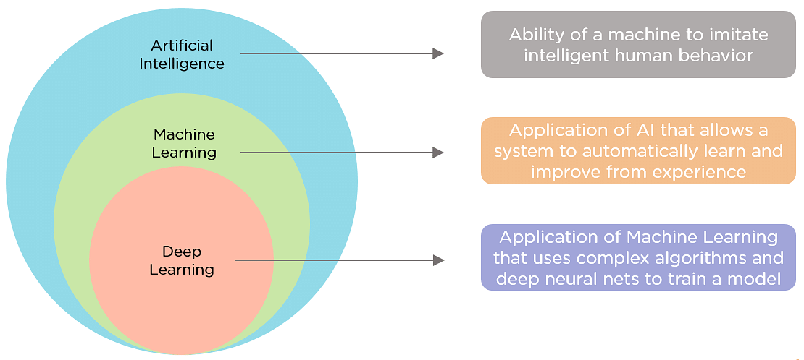
Similarities of AI, ML and Deep learning
AI, Machine learning and deep learning are methods that are relied on tools, techniques, and algorithms to analyze and utilize large volumes of data. These all depends upon the neural networks which the computer system modelled on human analysis patterns (Lalita, 2021)
05

Slide 6
Difference AI, ML and Data Science
- Artificial intelligence (AI) uses algorithms and data science methods to build and manage sophisticated systems that simulate human intellect.
- Machine learning is like a toddler, discovering the difference between two colors by using their vision. We need to feed data to make outcome better, Show what is right and wrong
- Deep learning have many neural networks which does full data analysis with massive dataset which the human mind cannot calculate (Lalita, 2021)
06

Slide 7
03
Question 03
(AI)

Slide 8
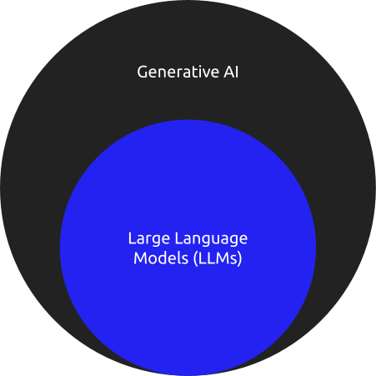
Generative AI & Large Language Models
07
Generative AI can create contents like text, images, audio or videos. Like humans might generate. They learn patterns and structures in data which they are trained and use it for generating new content with that.
LLMs is a type of generative AI which is capable of creating human languages. These models are trained highly with text data and learn to understand the pattern to generate human like language. (Yasir, 2023)

Slide 9
04
Question 04
(AI)

Slide 10
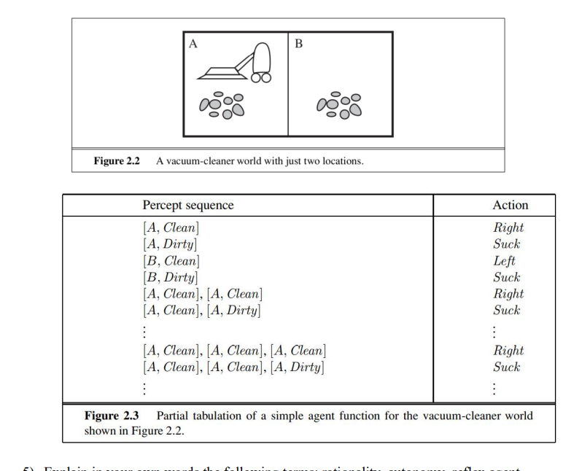
Rationality of various vacuum-cleaner agent functions
09
(a) Show Vacuum cleaner is Rational
Given figure has two room A and B with dirt.
Goal is to clean both rooms by taking actions.
With the sequences given in the figure,
Scan the area A and suck if dirt of room A, Cleaned A.
Turn Vacuum cleaner right and move to Room B
Scan Area B and Suck if dirt of room B, Cleaned B.
Stop Vacuum cleaner after cleaning dirt
The presented method moves the agent towards its goal of cleaning all rooms while minimize movements, making it Rational.

Slide 11
Rationality of various vacuum-cleaner agent functions
10
(b) Show Rational Agent Function, and required Internal State
Depending upon the movement if it costs one point then agent might minimize the cost while cleaning the rooms. It will require the an internal state to keep track of its position, cleanliness of the rooms and total costs. With the internal state the agent can make decisions to minimize cost efficiently
(c) Possible agent designs for the cases
It makes sense for the agent to learn from its experience when rooms becomes dirty, and the environment is unfamiliar. To enhance performance over time, the agent should understand patterns of dirt, determine which rooms is mostly dirty, effective cleaning routes, and efficient exploration tactics.

Slide 12
05
Question 05
(AI)

Slide 13
Terms of artificial intelligence
12
(a) Rationality
Ability to make decision for better outcome or make agent to do right thing. E.g. Recommending best deals while shopping.
(b) Autonomy
To make agent to operate independently, while making decisions and taking actions without any kind of direct human intervention. E.g. Self driving car (Calvo, n.d.)
(c) Reflex Agent
Makes sole decisions without any experience or future consequence, with certain rules. E.g. Vacuum cleaning if location is dirty. (Jacques, 2019)
(d) Model-based Agent
Makes decision based on the understanding of the environment, beyond its current percept. It uses models to predict the outcomes and plan accordingly. E.g. Chess Playing AI, has rules for future moves. (Jacques, 2019)

Slide 14
Terms of artificial intelligence
13
(e) Goal-based Agent
An agent will choose action as to achieve its goal. Agent should decide the sequences of possible action before deciding if goal is achieved. E.g. Delivery Robots to navigate location unless the delivery is done in appropriate manner. (Jacques, 2019)
(f) Utility Based Agent
Agent measures the degree of happiness. It indicates a measure of success or happiness at a given state. E.g. AI personal Assistance senses or prioritize the urgency of task. (Jacques, 2019)
(g) Learning Based Agent
To build learning machines and then to teach those machines different scenarios. The agent is allowed to operate in initially unknown environment and then to become more competent than its initial state. Example: Email Spamming filter, which learns from user feedback on distinguishing the spam or not spam emails (Jacques, 2019)

Slide 15
06
Question 06 Building Recommendation System using 6 phases of building an intelligent knowledge-based system
(AI)

Slide 16
(a) Access the problem
Build a recommendation system that suggests personalized products to users based on their preferences and behavior.
14
(c) Develop a Prototype System
Select a suitable recommendation algorithm such as collaborative filtering, content-based filtering, or hybrid approaches.
(b) Acquire Data and Knowledge
Collect data on user interactions such as browsing history, purchase history, items viewed, items added to cart, and items purchased.

Slide 17
15
(d) Develop a Complete System
Experiment with advanced recommendation algorithms and techniques such as matrix factorization, deep learning, or reinforcement learning to improve recommendation quality and personalization
(f) Integrate and Maintain the System
Roll out the recommendation system to the production environment of the e-commerce platform.
(e) Evaluate and Revise the System
Compare the performance of different recommendation algorithms or strategies through A/B testing experiments with a subset of users

Slide 18
References
Manning, Christopher. Artificial Intelligence Definitions. Stanford University, Sept. 2020.
Bansall, Sahil. “Agents in Artificial Intelligence - GeeksforGeeks.” GeeksforGeeks, 6 Aug. 2019, www.geeksforgeeks.org/agents-artificial-intelligence
Pinker, Steven . “Rationality | Definition & Facts | Britannica.” Www.britannica.com, 12 July 2022, www.britannica.com/topic/rationality.
R., Lalita. Artificial Intelligence (AI). 2021, www.taylorfrancis.com/chapters/edit/10.1201/9781003005629-3/ai-vs-machine-learning-vs-deep-learning-lalitha
16

Slide 19
References
17
Gamieldien, Yasir. “Innovating the Study of Self-Regulated Learning: An Exploration through NLP, Generative AI, and LLMs.” Vtechworks.lib.vt.edu, 12 Sept. 2023, vtechworks.lib.vt.edu/items/97334c0c-9eee-464b-8a79-b3145de245de
Calvo, Rafael A., et al. “Supporting Human Autonomy in AI Systems: A Framework for Ethical Enquiry.” Philosophical Studies Series, vol. 140, 2020, pp. 31–54, link.springer.com/chapter/10.1007%2F978-3-030-50585-1_2#Sec2, https://doi.org/10.1007/978-3-030-50585-1_2.
Fleuriot, Jacques , et al. Intelligent Agents and Their Environments. 15 Jan. 2019, www.inf.ed.ac.uk/teaching/courses/inf2d/timetable/01_Intelligent_Agents.pdf
Cui, Author Chris. “How to Build an Artificial Intelligent System (I).” C. Cui’s Blog, 4 Sept. 2019, cuicaihao.com/2019/09/04/how-to-build-an-artificial-intelligent-system

Slide 20
Thanks!
Any questions?
Please, keep this slide as attribution

